Slide 1


01
INTRODUCTION
What is IOT and Cloud and where do we use it?
fatmir-0@student.ltu.se

Slide 2






IOT EXPONENTIAL GROWTH & USAGE ^{[1,2]}
Smart Healthcare
Smart Agriculture
Smart Manufacturing
There has been an exponential growth of IOT in the past few years and expected to increase.
Smart Env. Monitoring
Some of the areas IoT is used in…
fatmir-0@student.ltu.se 8/05/2022 | 01
Notes:
The rapid increase in connected device (or IoT device) usage by commercial entities and consumers is changing the topography of the internet Connected devices have been designed to fulfill functional requirements (i.e. observe, control and maintain a piece of machinery remotely), but have often failed at incorporating proper green aspects in their design. The integration of the Internet of things and cloud computing has led to the emergence of new classes of applications ranging from smart healthcare, smart and precision agriculture, smart manufacturing to smart environmental monitoring. The rapid surge in the use of these applications is expected to generate massive amounts of data with different characteristics that are yet not studied.

Slide 3
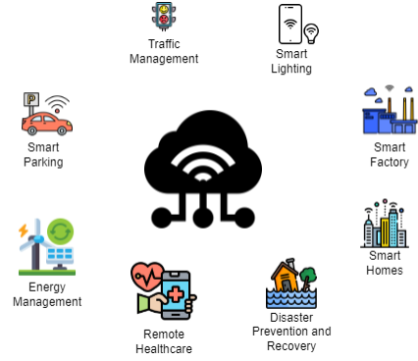
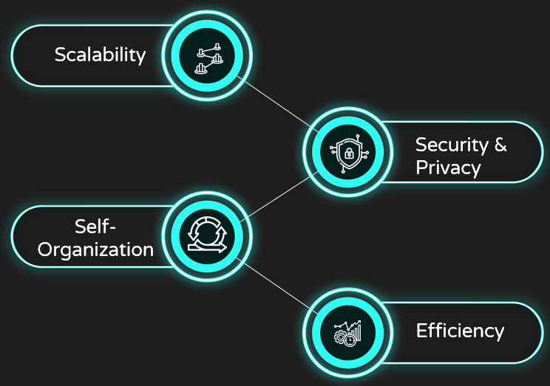
On demand self service
Broad Network Access
CLOUD COMPUTING …
What is Cloud Computing?
Uses of Cloud Computing and IoT
Challenges of using Cloud Computing in IoT
Resource Pooling
Rapid Elasticity
Measured Service
Why Cloud Computing is needed for IoT
Supports Volume
Supports Velocity
Supports Elasticity
fatmir-0@student.ltu.se 8/05/2022 | 02

Slide 4

02
PROBLEM STATEMENT
The challenges, definite problem, and the hypothesized solution
fatmir-0@student.ltu.se

Slide 5

Problem Statement
We hypothesize that each IoT-enabled application may exhibit a diverse range of characteristics that if modelled correctly, may lead to efficient distributed systems. This thesis aims to study the traffic characteristics of an IoT-enabled healthcare application to build intelligent policies for efficient scalable IoT-cloud systems.
fatmir-0@student.ltu.se 8/05/2022 | 03

Slide 6

DOMAIN
EFFICIENCY
Problem Statement
SCALABILITY
IoT-enabled healthcare
In terms of response time and cost
Scalable IoT-cloud systems
fatmir-0@student.ltu.se 8/05/2022 | 04

Slide 7

03
AIMS, RESEARCH QUESTIONS & CONTRIBUTIONS
fatmir-0@student.ltu.se

Slide 8
RQ1.
RQ2.
RESEARCH QUESTIONS
RQ3.
A1.
C1.
Analyse IoT traffic data characteristics from a real use case in SSiO - data generated from the IoT system of old homes in Skelleftea, Sweden.
What are the traffic characteristics of an IoT Healthcare System?
A comprehensive analysis of how the real life workload can be modelled
A2.
C2.
What analytical model best approximates IoTHA traffic prediction/forecasting?
THESIS CONTRIBUTION
THESIS AIM
A comprehensive analysis of how the real life workload can be predicted
Build analytical models to depict the traffic workload prediction from the IoTHA
A3.
How do we integrate green elastic policies into IoTHA in the Cloud environment?
C3.
Utilise the analytical model to implement and test the load balancing algorithm for elasticity and cost in cloud scenario.
A load balancing algorithm that can be utilised to use the real life workload prediction algorithm to select and deselect in advance the best virtual machines for a cloud platform and measure response time and cost
fatmir-0@student.ltu.se 8/05/2022 | 05

Slide 9

04
METHODOLOGY
The macro and micros of methodology
fatmir-0@student.ltu.se

Slide 10
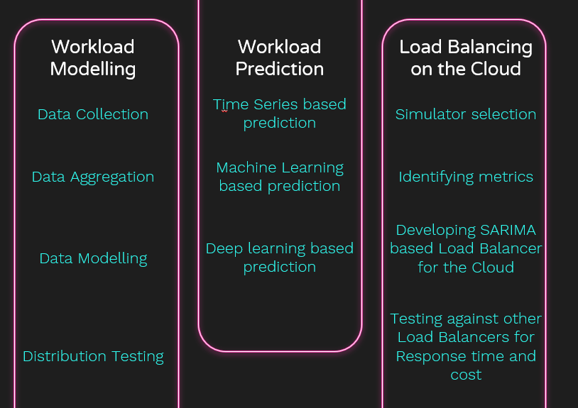
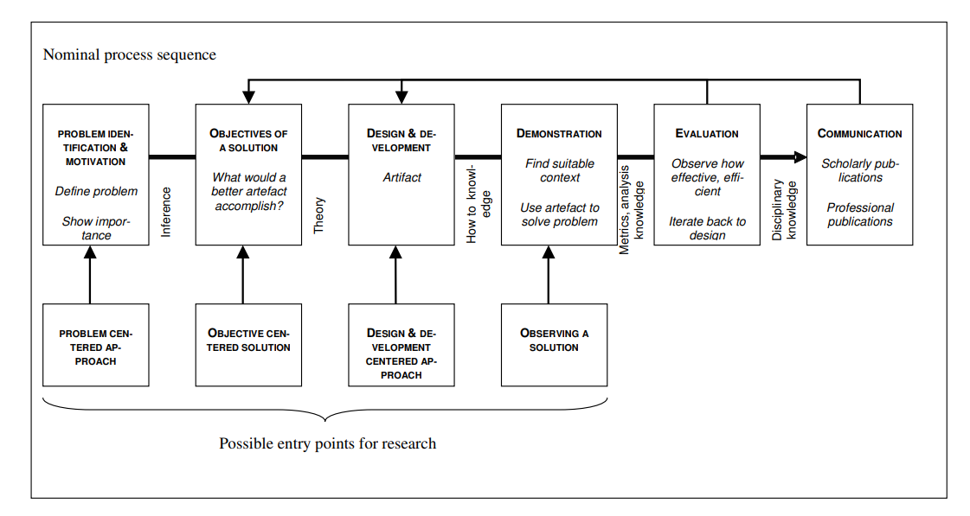
MACROMETHODOLOGY
MICROMETHODOLOGY
fatmir-0@student.ltu.se 8/05/2022 | 06

Slide 11

05
BACKGROUND STUDY
Understand existing work done in this field
fatmir-0@student.ltu.se

Slide 12
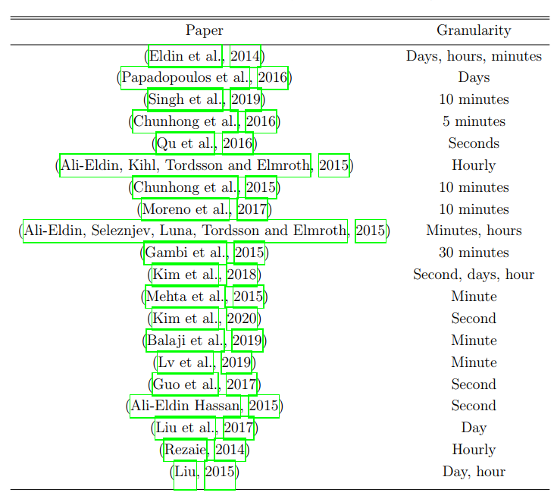
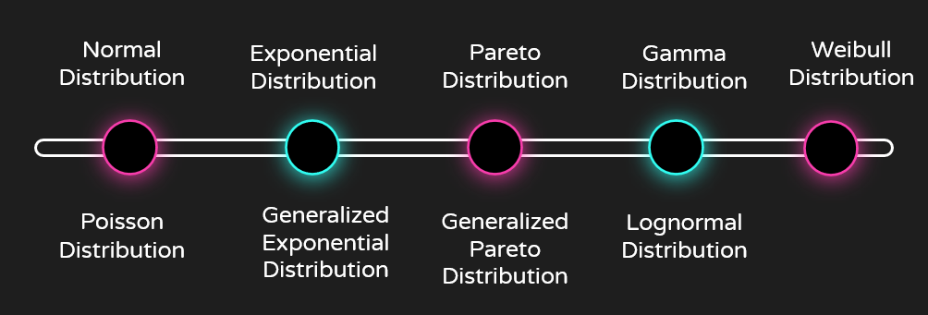
WM1.
Wikipedia workload modelling
New York City Taxi Trip Data Workload modelling
Microsoft T-Drive Trajectory Dataset Workload modelling
Chicago Taxi Trips Dataset Workload modelling
WORKLOAD MODELLING
WM2.
Granularity Testing
WM3.
Distribution Testing
fatmir-0@student.ltu.se 8/05/2022 | 07

Slide 13

WP1.
WP2.
WORKLOAD PREDICTION
WP3.
Holt-Winters, AR, ARMA, ARIMA, GARCH, Exponential Smoothing, ETS.
Time Series based Prediction
Selected
Linear and Gaussian SVMs, Decision Tree, Random Forest, Gradient Boosting, Extra Trees
Machine Learning based prediction
SARIMA
Deep Learning based prediction
RNN, LSTM, Bi-LSTM, DNN
fatmir-0@student.ltu.se 8/05/2022 | 08

Slide 14
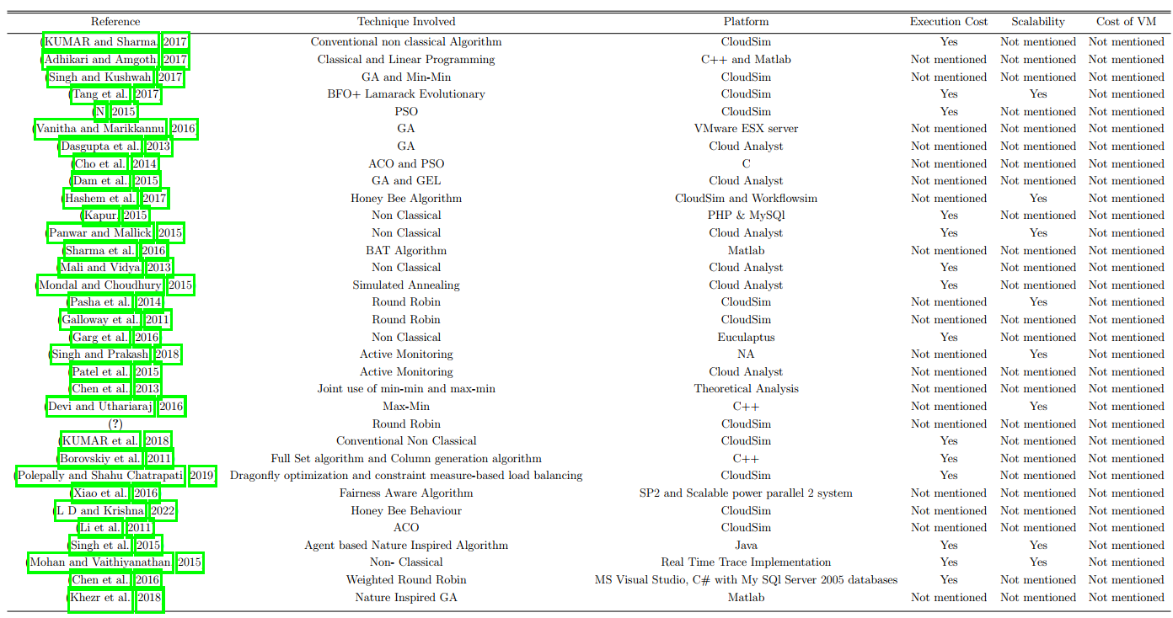
LB1.
LB2.
LOAD BALANCING ON THE CLOUD
LB3.
Simulator Selection
Metrics Identification
Other Load Balancers
fatmir-0@student.ltu.se 8/05/2022 | 09

Slide 15

Simulator Selection
Metric Identification
Other Load Balancers
LOAD BALANCING ON THE CLOUD
CloudSim Plus
CloudAnalyst
Response Time
Cost of VM
Active Load Balancer
Round Robin Load Balancer
fatmir-0@student.ltu.se 8/05/2022 | 10

Slide 16

06
DATASET
Data collection source
fatmir-0@student.ltu.se

Slide 17
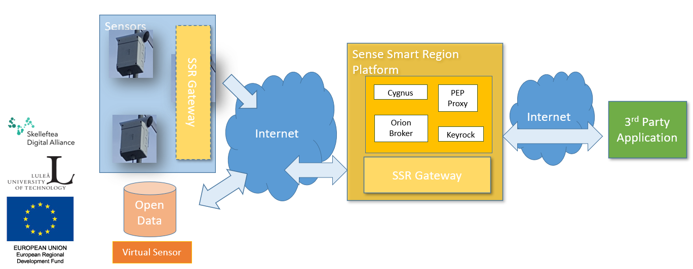
SSiO ARCHITECTURE
fatmir-0@student.ltu.se 8/05/2022 | 11

Slide 18
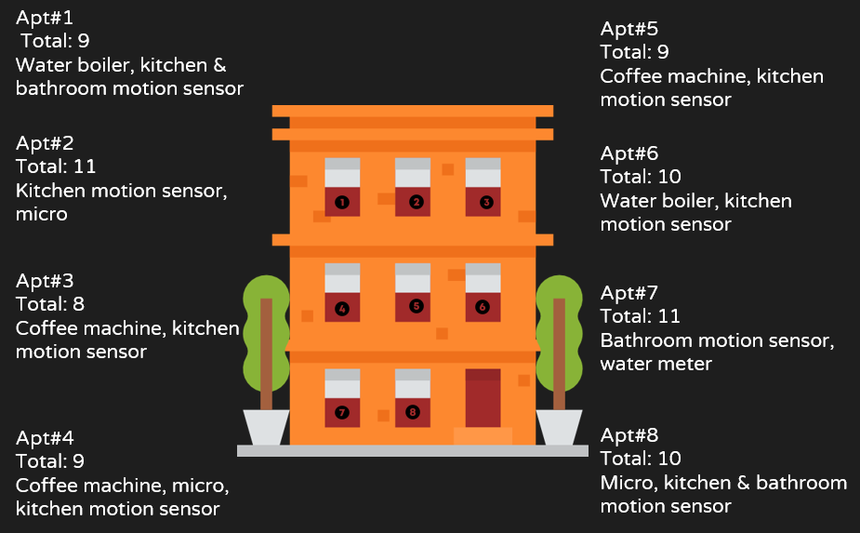
DATASET
fatmir-0@student.ltu.se 8/05/2022 | 12

Slide 19

07
WORKLOAD MODELLING
How to model the workload
fatmir-0@student.ltu.se

Slide 20
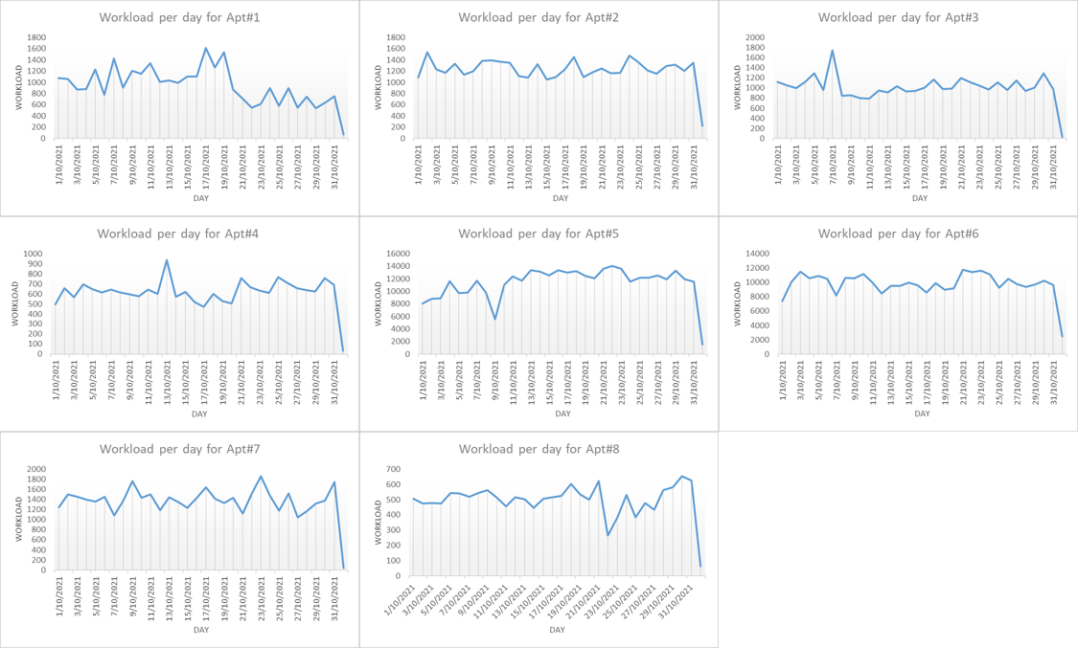
DAILY MODELLING APT. WISE
fatmir-0@student.ltu.se 8/05/2022 | 13

Slide 21
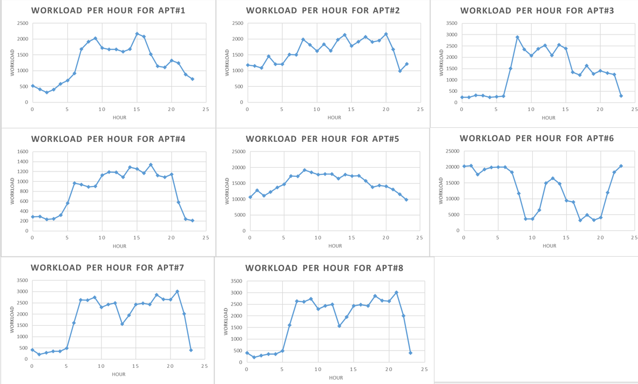
HOURLY MODELLING APT. WISE
fatmir-0@student.ltu.se 8/05/2022 | 14

Slide 22
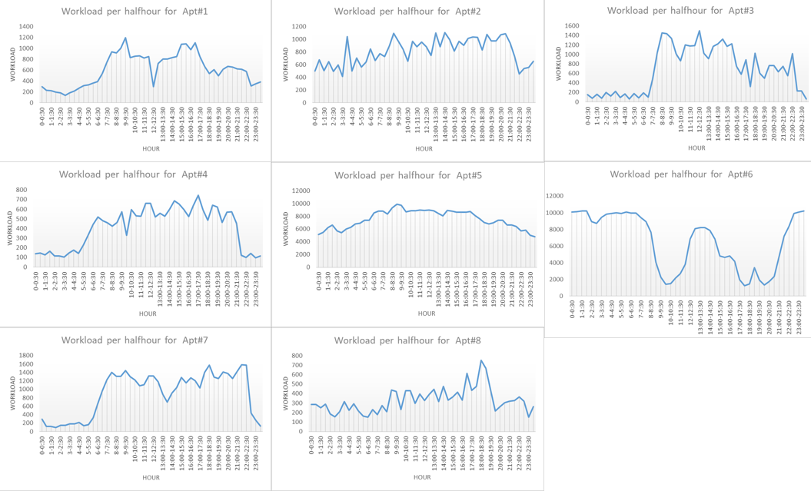
HALF HOURLY MODELLING APT. WISE
fatmir-0@student.ltu.se 8/05/2022 | 15

Slide 23
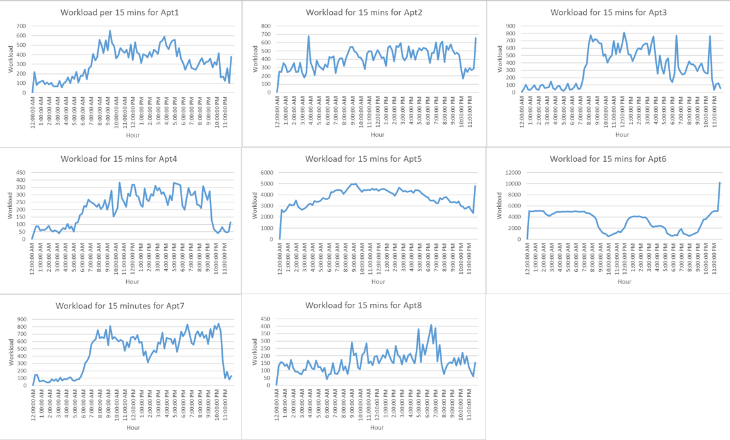
QUARTER HOURLY MODELLING APT. WISE
fatmir-0@student.ltu.se 8/05/2022 | 16

Slide 24
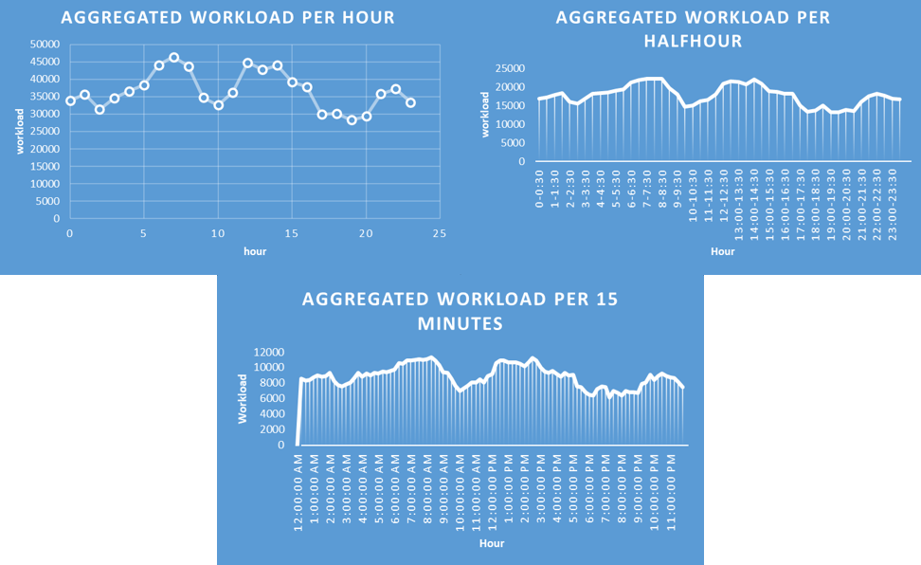
AGGREGATED MODELLING FOR OCT. 2021
fatmir-0@student.ltu.se 8/05/2022 | 17

Slide 25
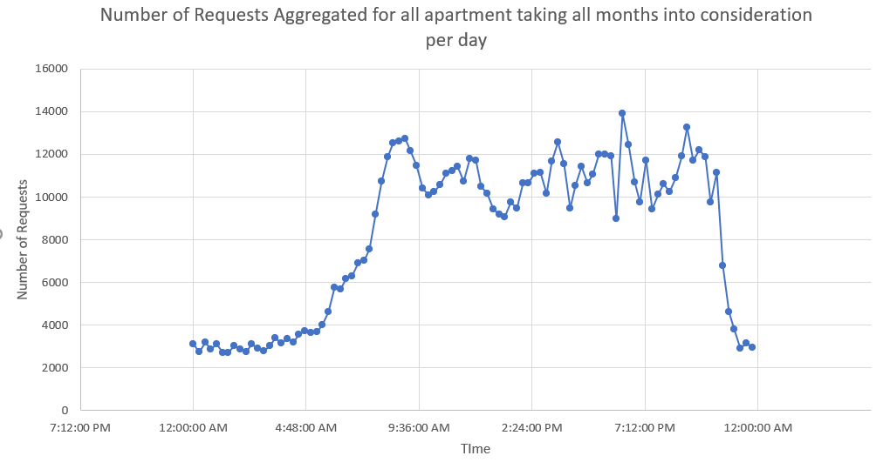
AGGREGATED QUARTER HOURLY MODELLING
fatmir-0@student.ltu.se 8/05/2022 | 18

Slide 26
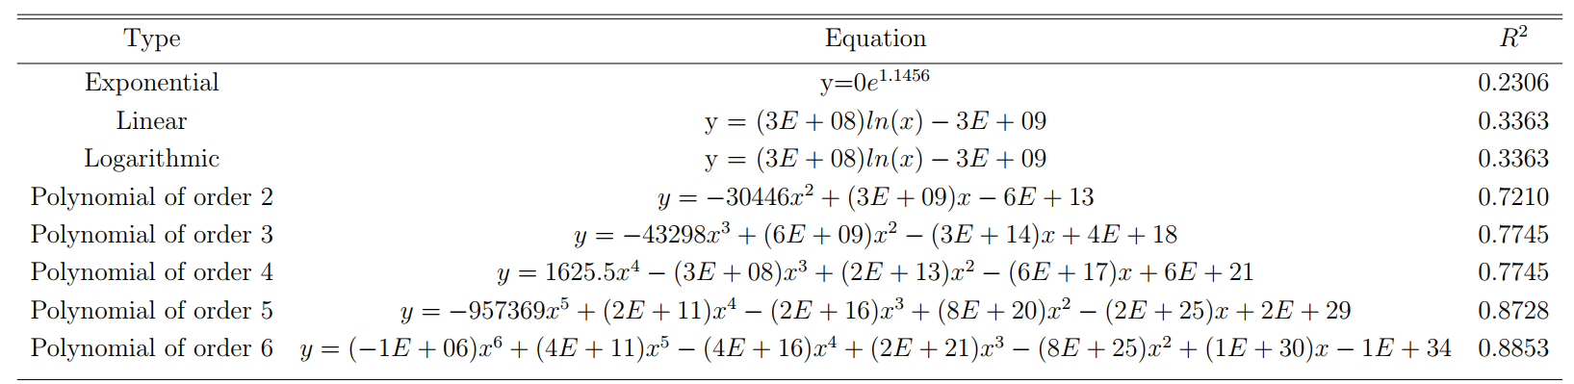
TRENDLINE ANALYSIS
fatmir-0@student.ltu.se 8/05/2022 | 19

Slide 27
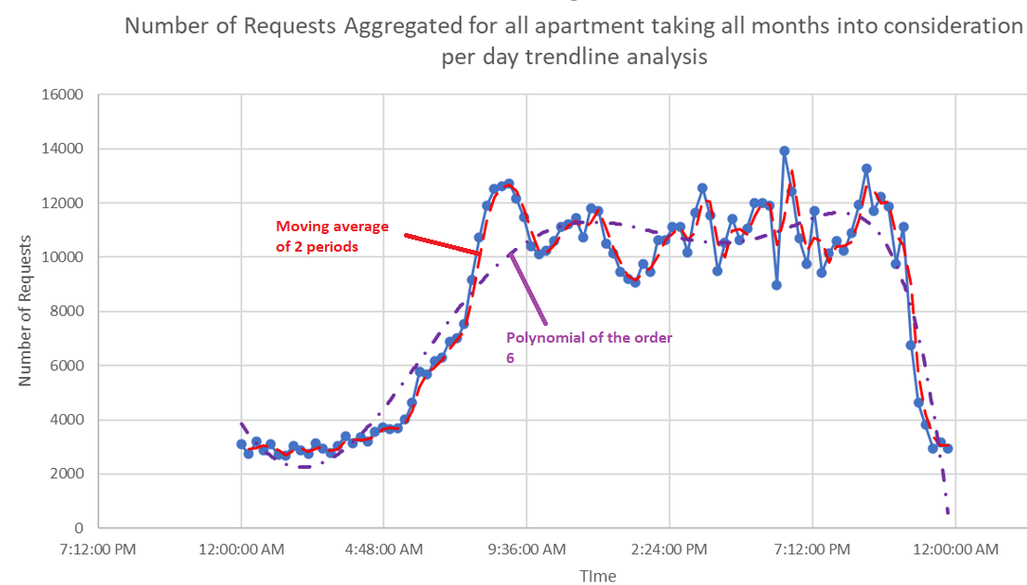
TRENDLINE ANALYSIS
fatmir-0@student.ltu.se 8/05/2022 | 20

Slide 28

08
WORKLOAD PREDICTION
How to predict using the workload
fatmir-0@student.ltu.se

Slide 29
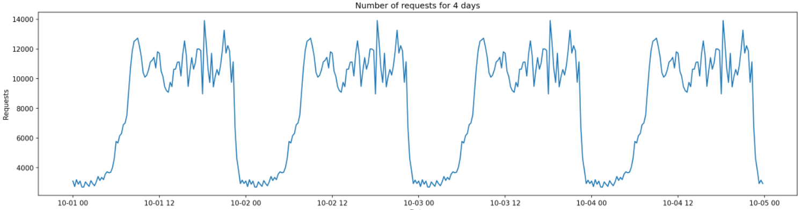
15 MINUTES WISE AGGREGATED WORKLOAD MODELLING FOR PREDICTION
fatmir-0@student.ltu.se 8/05/2022 | 21

Slide 30




ARIMA
SARIMA
ALGORITHMS CONSIDERED FOR WORKLOAD PREDICTION
Random Forest
LSTM
fatmir-0@student.ltu.se 8/05/2022 | 22

Slide 31
p
d
PARAMETERS FOR ARIMA
q
Refers to the number of lag observations. This is also sometimes known as the lag order.
Refers to the number of times that the observations have been diﬀerenced. This is also sometimes known as the degree of diﬀerencing.
Refers to the dimension of the moving average window. This is also sometimes known as the order of moving average.
fatmir-0@student.ltu.se 8/05/2022 | 23

Slide 32

p and P
q and Q
PARAMETERS FOR SARIMA
d and D
s
Lag order
Order of moving average.
Degree of diﬀerencing
Seasonal length in the data
fatmir-0@student.ltu.se 8/05/2022 | 24

Slide 33
N_estimators
Other parameters
PARAMETERS FOR RANDOM FOREST
Split criterion
100
Default
Squared_error
fatmir-0@student.ltu.se 8/05/2022 | 25

Slide 34
Optimizer
Hidden layer
PARAMETERS FOR LSTM
Learning rate
Number of Neurons
Adam
1
1E-06
32
fatmir-0@student.ltu.se 8/05/2022 | 26

Slide 35

09
TESTBED DESIGN FOR SIMULATION OF LOAD BALANCING ON CLOUD USING SARIMALB
Flow of how the load balancing will work on SARIMA
fatmir-0@student.ltu.se

Slide 36
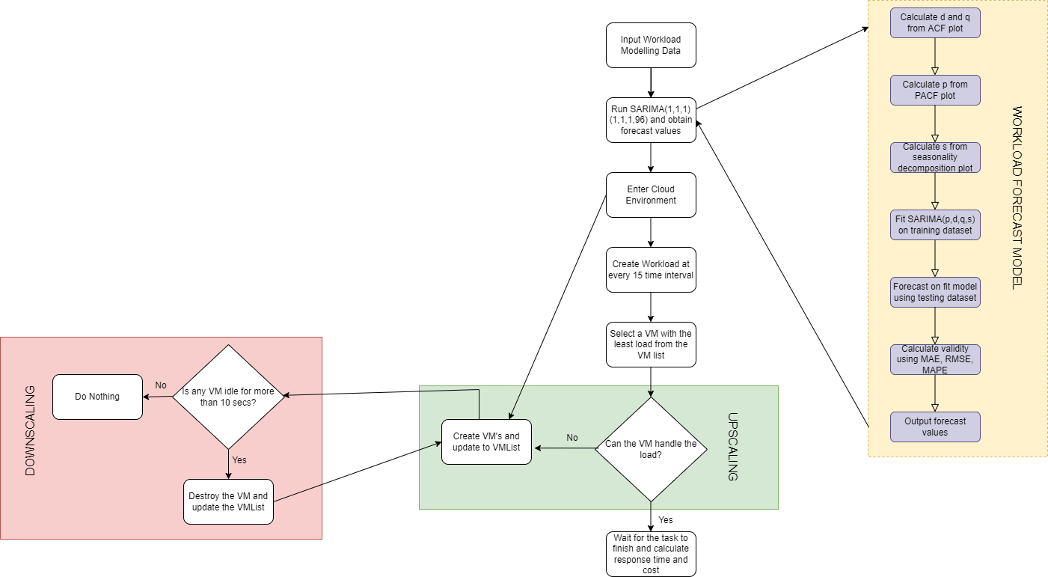
fatmir-0@student.ltu.se 17/12/2021 | 03

Slide 37
10
RESULTS FOR DATASET AND WORKLOAD MODELLING
fatmir-0@student.ltu.se

Slide 38
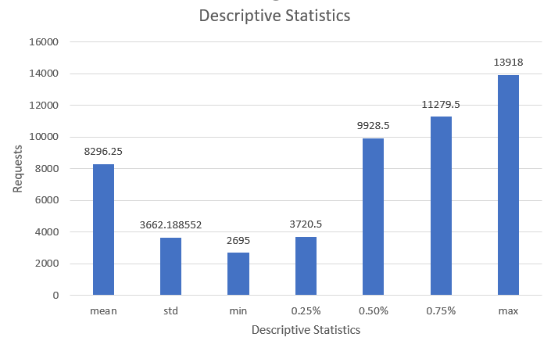
DESCRIPTIVE STATISTICS
fatmir-0@student.ltu.se 8/05/2022 | 28

Slide 39
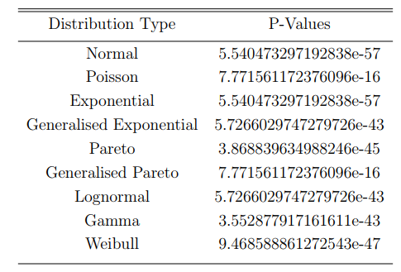

Kolmogorov–Smirnov test
TEST FOR DISTRIBUTION
compares the data distribution with a known distribution and checks whether they are the same
fatmir-0@student.ltu.se 8/05/2022 | 29

Slide 40
11
RESULTS FOR WORKLOAD PREDICTION
fatmir-0@student.ltu.se

Slide 41
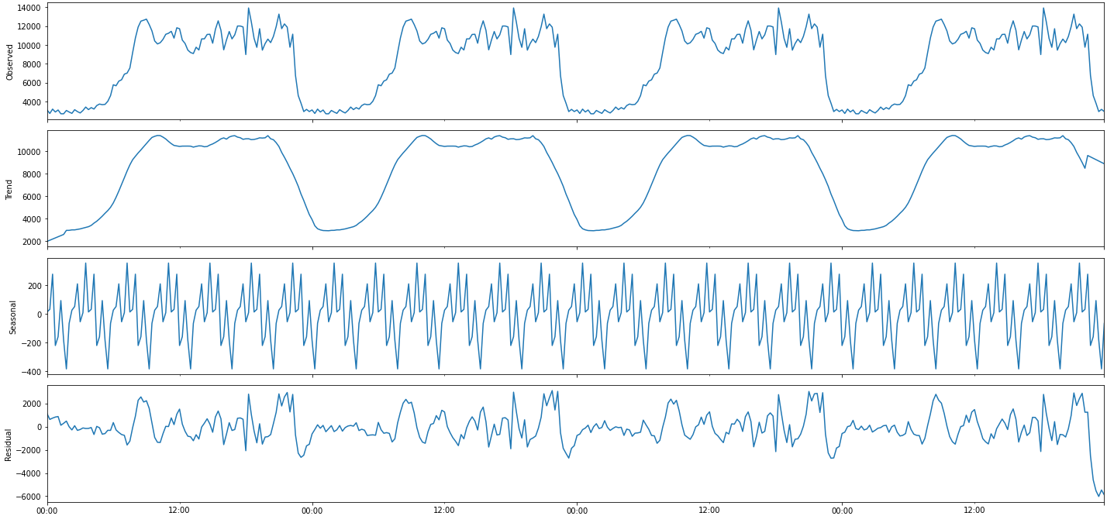
DECOMPOSITION OF THE DATASET
fatmir-0@student.ltu.se 8/05/2022 | 30

Slide 42
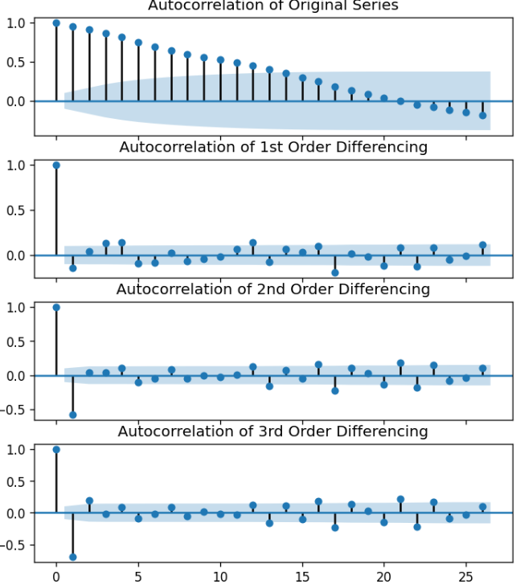
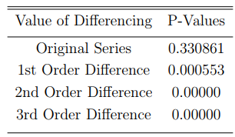
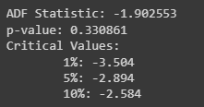
DATA STATIONARY
AUTOCORRELATION PLOT
ADF STAT. FOR DIFFERENCING
The value of d = 1 for this series
The value of q = 1 for this series
fatmir-0@student.ltu.se 8/05/2022 | 31

Slide 43
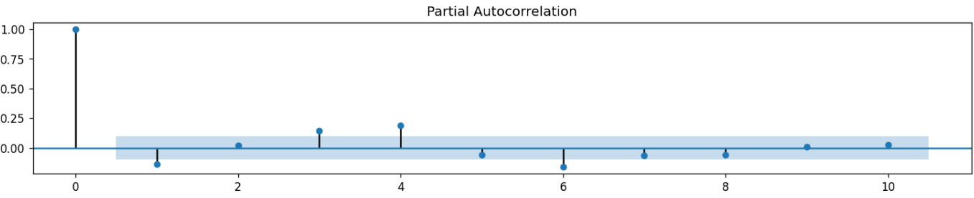
PARTIAL AUTOCORRELATION PLOT
The value of p = 1 for this series
fatmir-0@student.ltu.se 8/05/2022 | 32

Slide 44
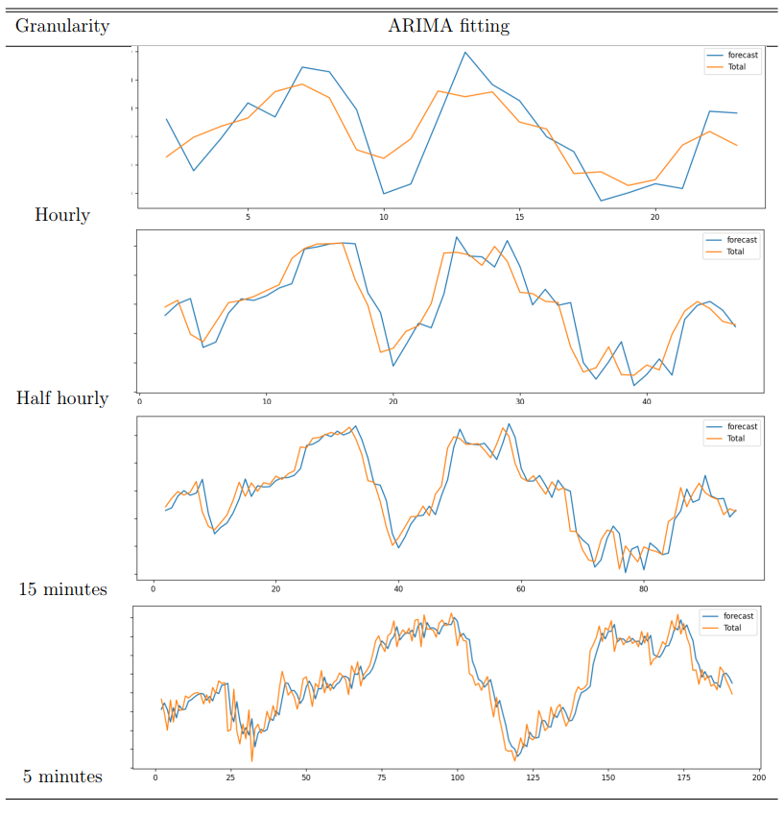
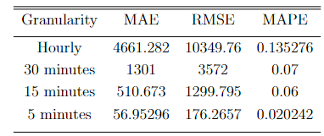
FITTING ARIMA(1,1,1)
Summary of errors for different granularity for ARIMA fitting
8/05/2022 | 33

Slide 45
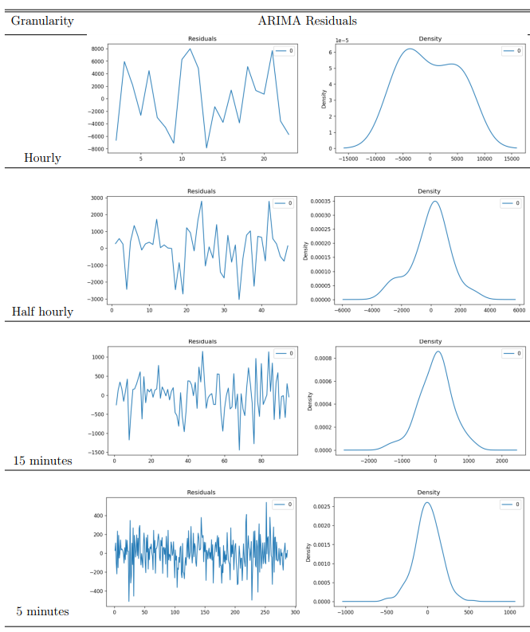
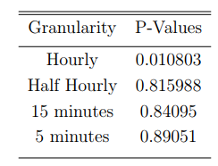
FITTING ARIMA(1,1,1) RESIDUALS
Summary of Ljung-Box test for diﬀerent granularity for ARIMA fitting
8/05/2022 | 34

Slide 46
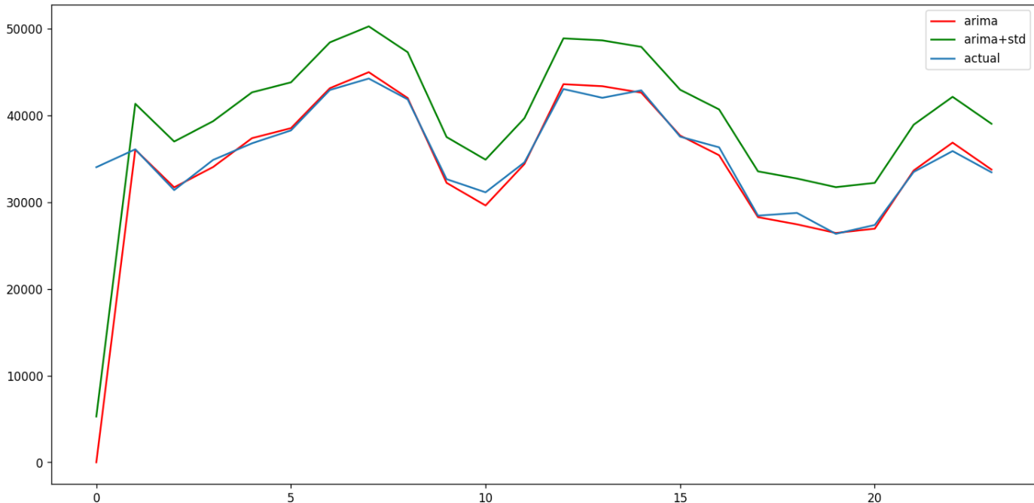
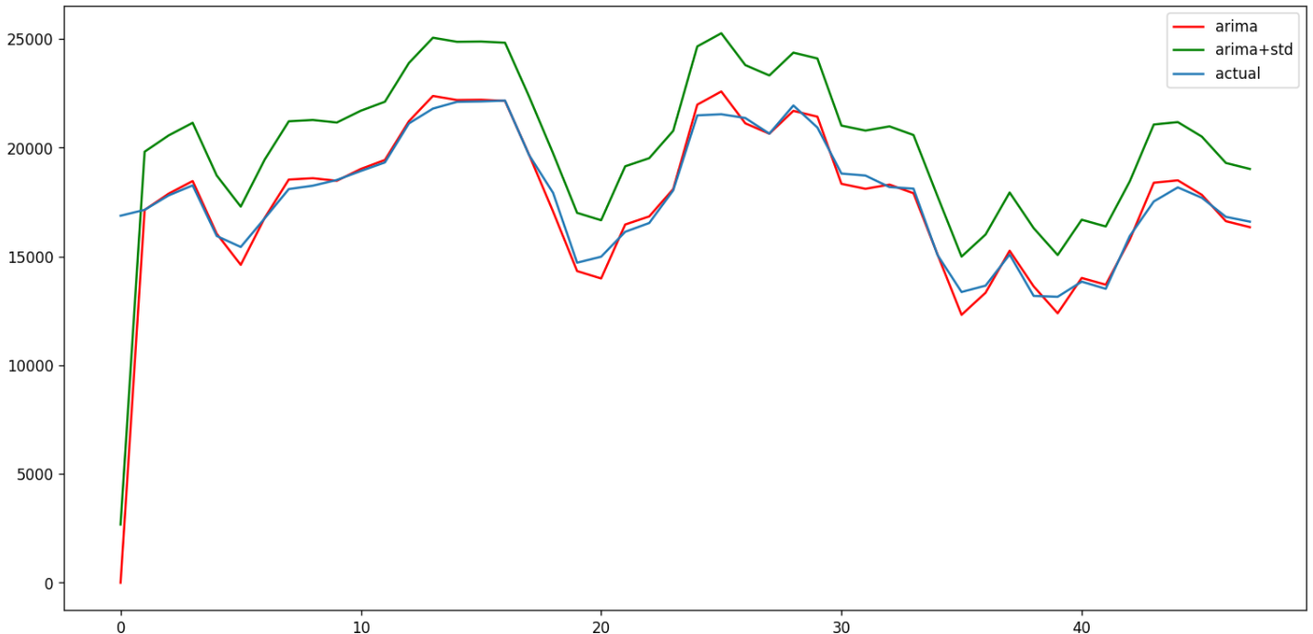
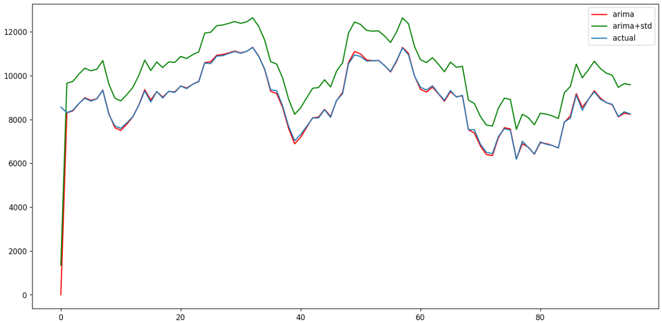
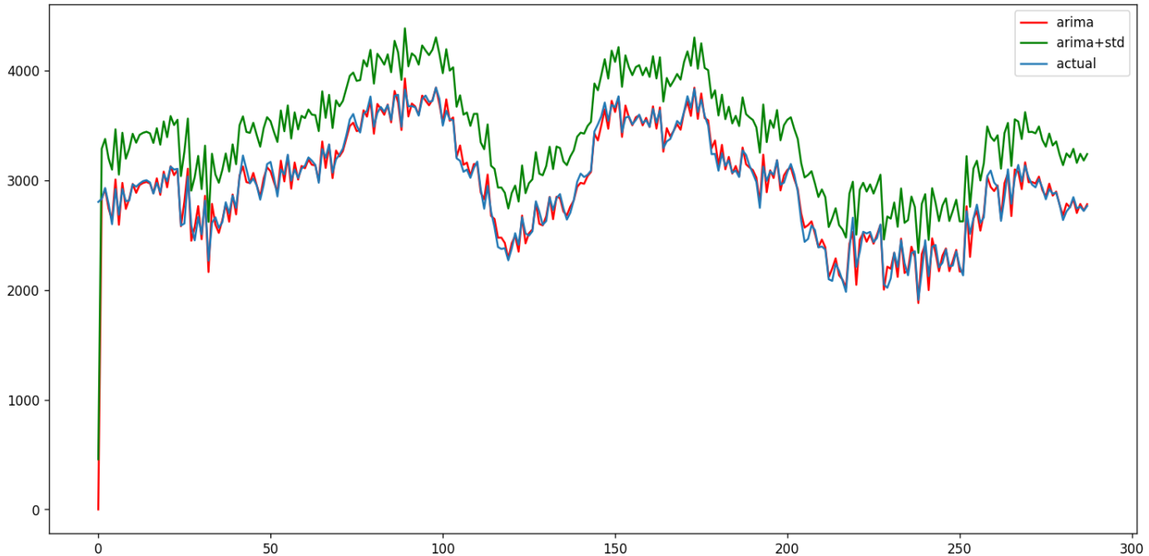
Hourly with ARIMA + STD of the dataset
Halfhourly with ARIMA + STD of the dataset
MITIGATING THE UNDERPROVISIONING
Quarter Hourly with ARIMA + STD of the dataset
5 minutes with ARIMA + STD of the dataset
fatmir-0@student.ltu.se 8/05/2022 | 35

Slide 47
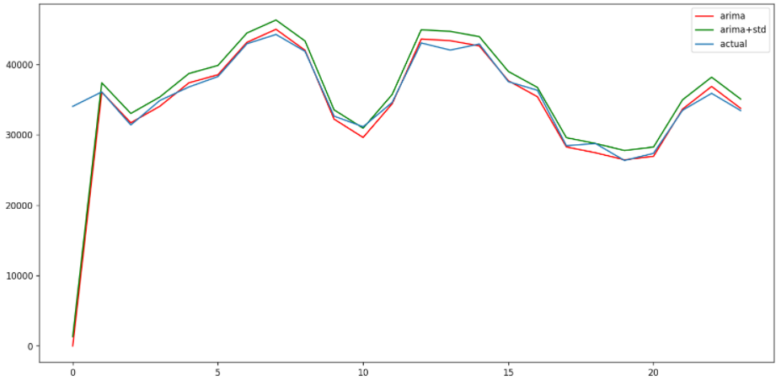
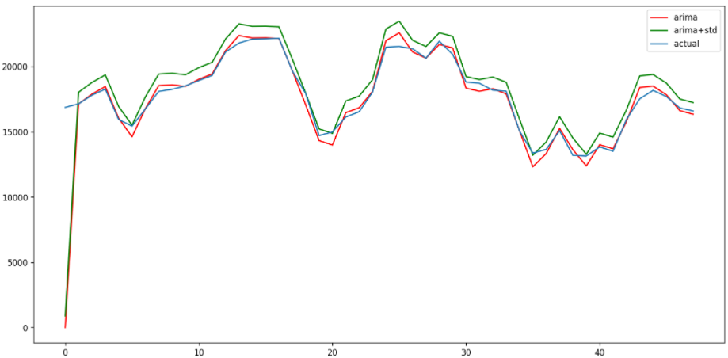
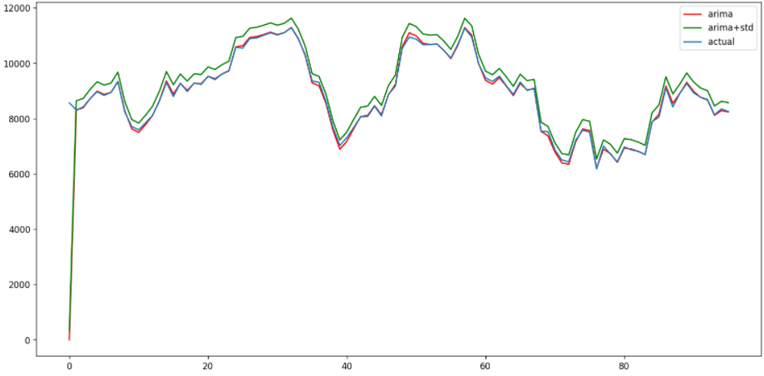
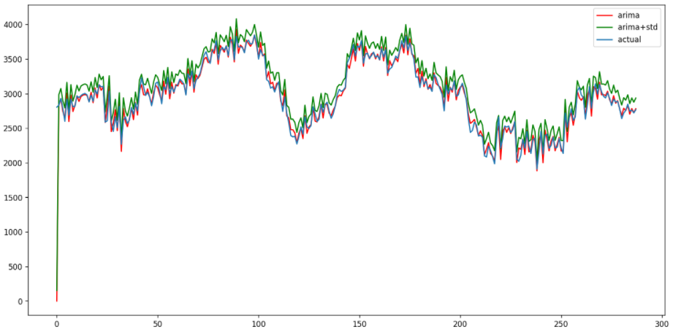
Hourly with ARIMA + STD/4 of the dataset
Halfhourly with ARIMA + STD of the dataset
MITIGATING THE UNDERPROVISIONING
Quarter Hourly with ARIMA + STD/3 of the dataset
5 minutes with ARIMA + STD of the dataset
fatmir-0@student.ltu.se 8/05/2022 | 36

Slide 48
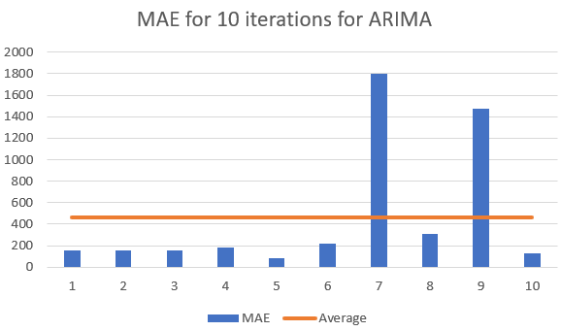
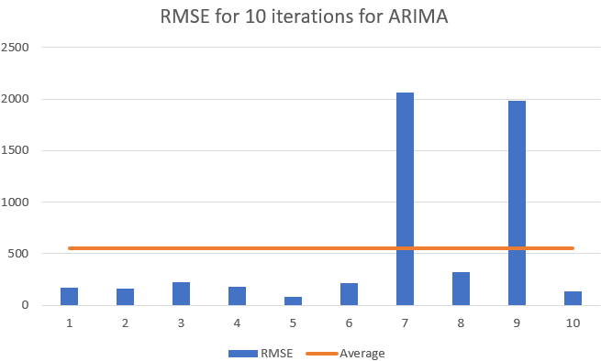
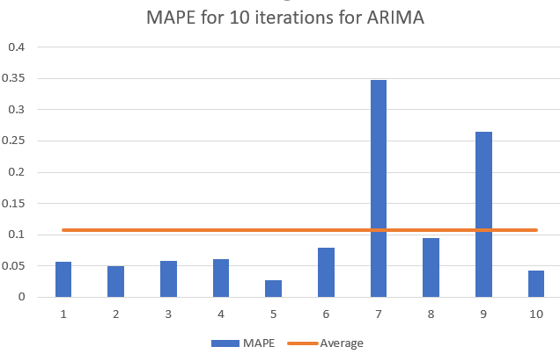
Summary of MAE, RMSE & MAPE for
ARIMA forecasting for 2 time periods
fatmir-0@student.ltu.se 8/05/2022 | 37

Slide 49
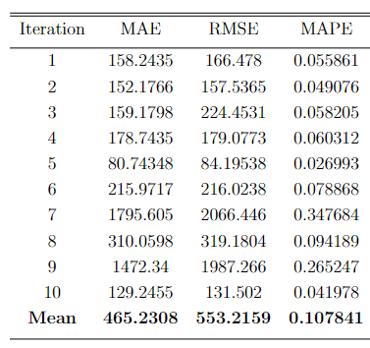
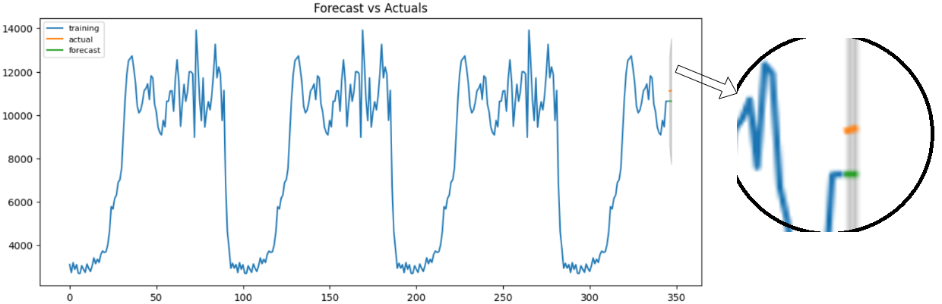
Summary of MAE, RMSE & MAPE for ARIMA forecasting for 2 time periods
fatmir-0@student.ltu.se 8/05/2022 | 38

Slide 50
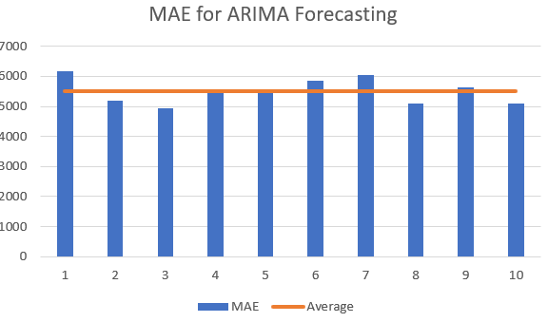
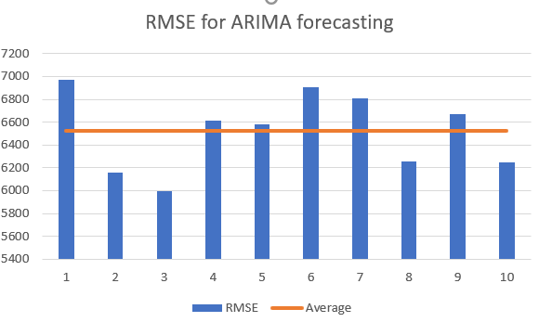
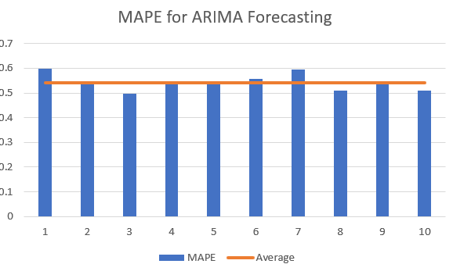
Summary of MAE, RMSE & MAPE for ARIMA forecasting for more time periods
fatmir-0@student.ltu.se 8/05/2022 | 39

Slide 51
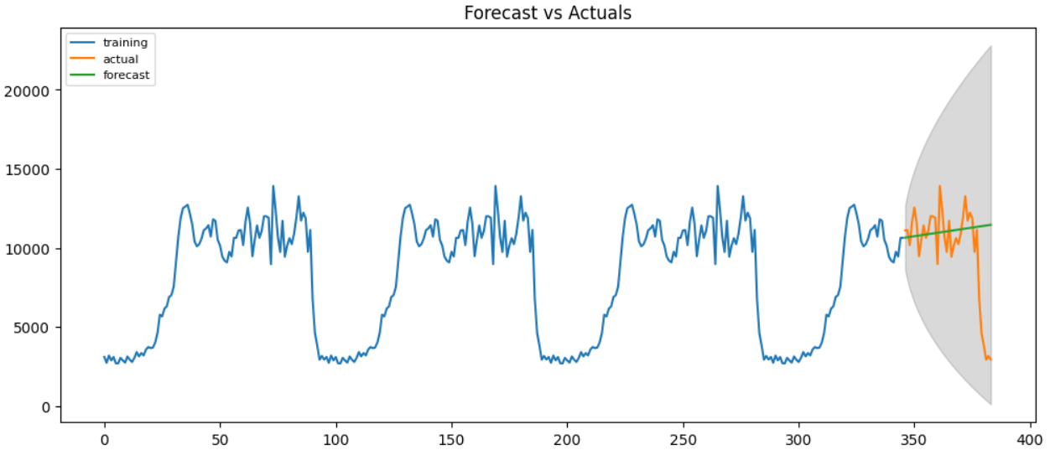
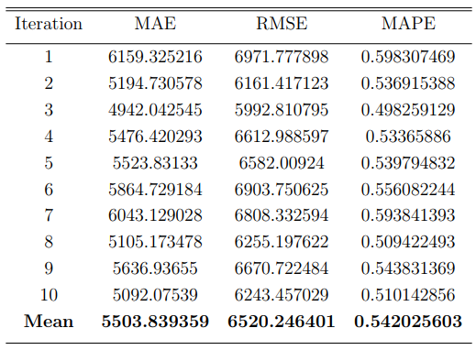
Summary of MAE, RMSE & MAPE for ARIMA forecasting for more time periods
fatmir-0@student.ltu.se 8/05/2022 | 40

Slide 52
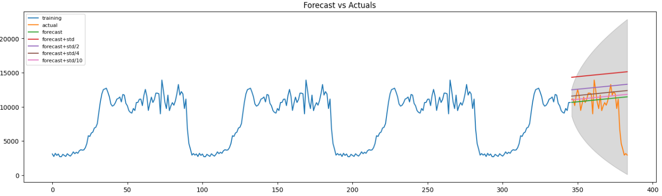
Summary of ARIMA forecasting for more
time periods with std. dev
fatmir-0@student.ltu.se 8/05/2022 | 41

Slide 53
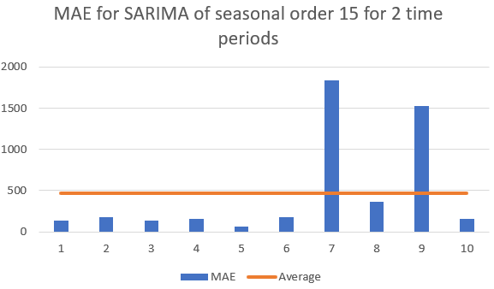


Summary of MAE, RMSE & MAPE for SARIMA forecasting for 2 time periods for seasonal order of 15
fatmir-0@student.ltu.se 8/05/2022 | 42

Slide 54


Summary of MAE, RMSE & MAPE for SARIMA forecasting for 2 time periods for seasonal order of 15
fatmir-0@student.ltu.se 8/05/2022 | 43

Slide 55



Summary of MAE, RMSE & MAPE for SARIMA forecasting for 2 time periods for seasonal order of 30
fatmir-0@student.ltu.se 8/05/2022 | 44

Slide 56


Summary of MAE, RMSE & MAPE for SARIMA forecasting for 2 time periods for seasonal order of 30
fatmir-0@student.ltu.se 8/05/2022 | 45

Slide 57



Summary of MAE, RMSE & MAPE for SARIMA forecasting for 2 time periods for seasonal order of 96
fatmir-0@student.ltu.se 8/05/2022 | 46

Slide 58


Summary of MAE, RMSE & MAPE for SARIMA forecasting for 2 time periods for seasonal order of 96
fatmir-0@student.ltu.se 8/05/2022 | 47

Slide 59


Summary of Residual Analysis for SARIMA forecasting for 2 time periods
Summary of Ljung-Box test for diﬀerent seasonality orders for SARIMA
fatmir-0@student.ltu.se 8/05/2022 | 48

Slide 60



Summary of MAE, RMSE & MAPE
for SARIMA forecasting for more time periods for seasonal order of 96
fatmir-0@student.ltu.se 8/05/2022 | 49

Slide 61


Summary of MAE, RMSE & MAPE
for SARIMA forecasting for more time
periods for seasonal order of 96
fatmir-0@student.ltu.se 8/05/2022 | 50

Slide 62



Summary of MAE, RMSE & MAPE for Random Forest
fatmir-0@student.ltu.se 8/05/2022 | 51

Slide 63


Summary of MAE, RMSE & MAPE for Random Forest
fatmir-0@student.ltu.se 8/05/2022 | 52

Slide 64



Summary of MAE, RMSE & MAPE for LSTM
fatmir-0@student.ltu.se 8/05/2022 | 53

Slide 65

Summary of MAE, RMSE & MAPE for LSTM
fatmir-0@student.ltu.se 8/05/2022 | 54

Slide 66


Comparison of MAE, RMSE & MAPE for all algorithms for more time periods
fatmir-0@student.ltu.se 8/05/2022 | 55

Slide 67



Comparison of MAE, RMSE & MAPE for ARIMA & SARIMA for 2 time periods
Summary of Ljung-Box test for diﬀerent seasonality orders for SARIMA
Summary of Diebold-Mariano test for diﬀerent metrics of forecast accuracy
fatmir-0@student.ltu.se 8/05/2022 | 56

Slide 68
12
RESULTS FOR SIMULATION OF LOAD BALANCING ON CLOUD USING SARIMALB
fatmir-0@student.ltu.se

Slide 69

Comparison of the means Response time
and cost for Diﬀerent Load Balancers for Diﬀerent number of VM’s
fatmir-0@student.ltu.se 8/05/2022 | 57

Slide 70

Comparison of the means Response time
and cost for Diﬀerent Load Balancers for Diﬀerent number of VM’s
fatmir-0@student.ltu.se 8/05/2022 | 58

Slide 71

Comparison of the means Response time
and cost for Diﬀerent Load Balancers for Diﬀerent number of VM’s
fatmir-0@student.ltu.se 8/05/2022 | 59

Slide 72
13
SUSTAINABILITY ANALYSIS
A walkthrough the different aspects of sustainability of the thesis
fatmir-0@student.ltu.se

Slide 73


SUSTAINABILITY ANALYSIS
fatmir-0@student.ltu.se 17/12/2021 | 11

Slide 74
14
DELIMITATION
Threat to the validity of the results
fatmir-0@student.ltu.se

Slide 75
D3.
D1.
DELIMITATIONS
D2.
Focused only on IoT Healthcare Applications
Implemented on a simulation – not on a real system
Processing and writing time into database is not considered
fatmir-0@student.ltu.se 8/05/2022 | 61

Slide 76
15
FUTURE WORK
Threat to the validity of the results
fatmir-0@student.ltu.se

Slide 77
F3.
F1.
FUTURE WORK
F2.
Include Queueing theory
Real costing model
F4.
Processing and writing time into database based on throughput
Deployment on real cloud
fatmir-0@student.ltu.se 8/05/2022 | 62

Slide 78
16
CONCLUSION
Are all the research questions answered?
fatmir-0@student.ltu.se

Slide 79

RQ1.
RQ2.
RQ3.
CONCLUSION
What are the traffic characteristics of an IoT Healthcare System?
What analytical model best approximates IoTHA traffic prediction/forecasting?
How do we integrate green elastic policies for cloud deployment into IoTHA?
fatmir-0@student.ltu.se 8/05/2022 | 63

Slide 80





Thank you! Tack så mycket
Any Questions?
fatmir-0@student.ltu.se

